Slide 1
Customer Analytics
Spring 2019
March 5, 2019

Slide 2
Course Overview

Slide 3
Agenda
Today’s objectives
Introductions
What will you learn?
Syllabus Runthrough

Slide 4
Today’s objectives
To define goals, objectives, requirements, and expectations for this course.
To outline how this course’s assignments (e.g., exercises, papers, reports) contribute to achieving this course’s goals and objectives.
To explain why the instructional methods (e.g., cases, lectures, readings, projects) were chosen to serve as this course’s subject matter.
To establish a learning environment that respects differences and diverse perspectives and makes all students feel welcome.
Notes:
w/Master - KK

Slide 5
Introductions 👋
Name, what you love most about BA, and a fun fact
Notes:
w/Master - KK

Slide 6
What will you learn?
What it feels like to fall.
Notes:
w/Master - KK

Slide 7

What will you learn?
The primary aim of this course is to help you fall into a pit of success in the arena of customer analytics.
https://blog.codinghorror.com/falling-into-the-pit-of-success/
Notes:
w/Master - KK

Slide 8
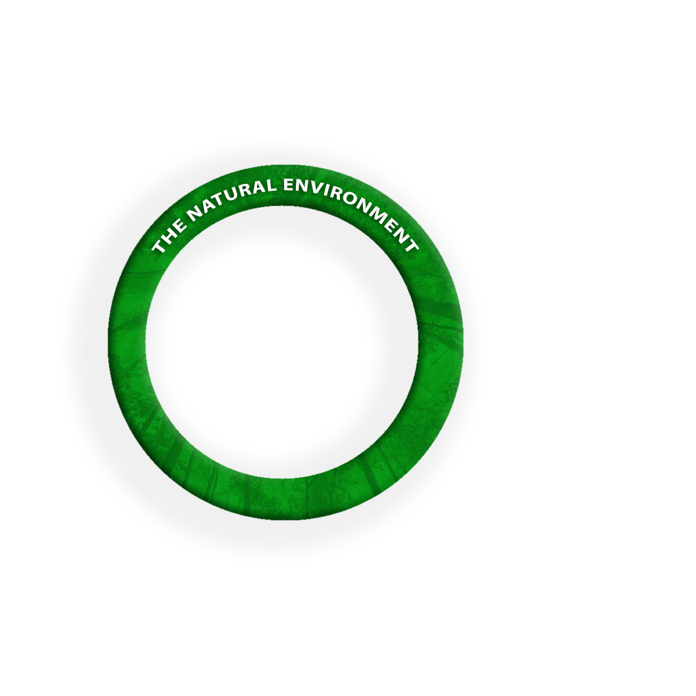
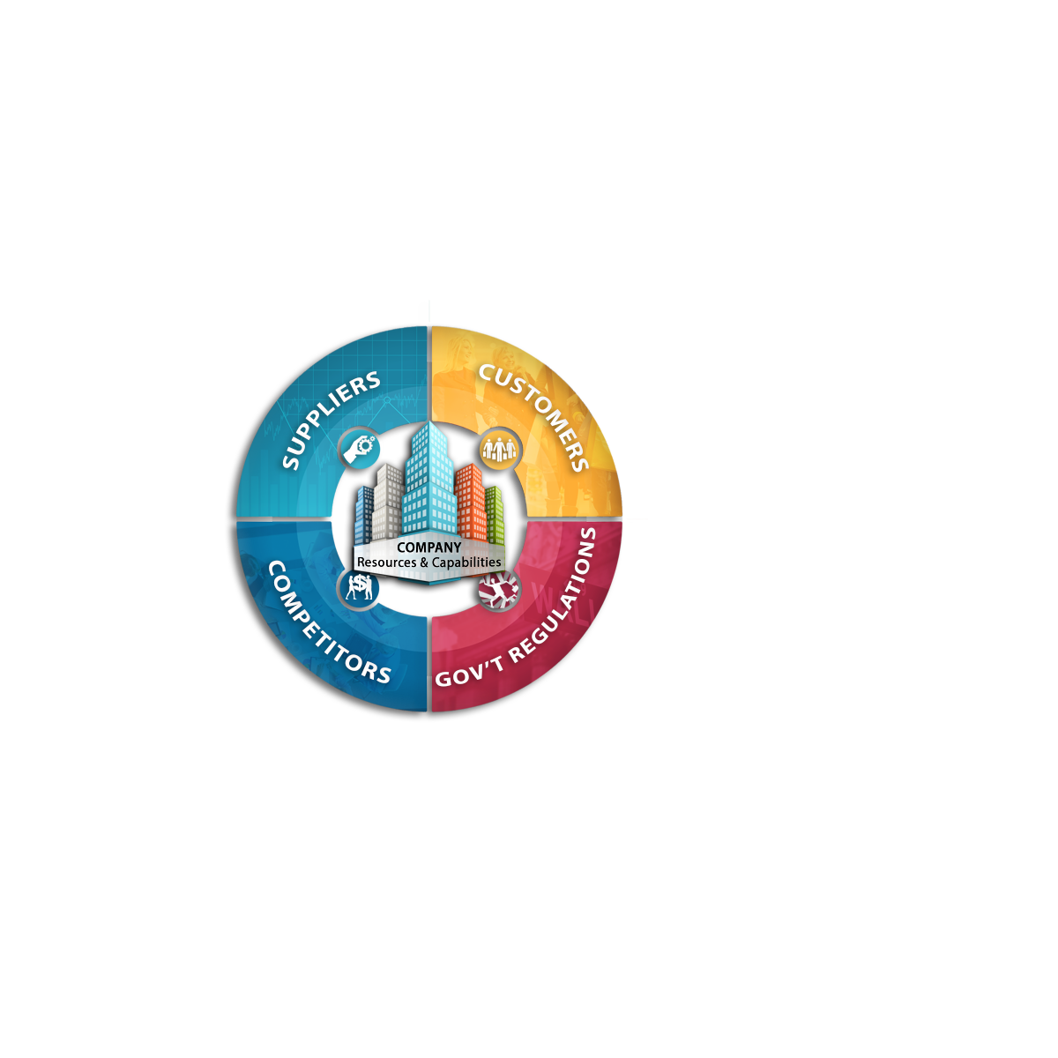
What will you learn?
How to generate, disseminate, and respond to market intelligence with data-informed insights to optimize collective value.
Notes:
w/Master - KK

Slide 9
What will you learn?
How to generate, disseminate, and respond to market intelligence with data-informed insights to optimize collective value.
Source: Dolan, Robert J. and Leslie K. John (2015). Marketing Intelligence. Harvard Business Publishing: Boston, MA.
Notes:
w/Master - KK

Slide 10
A data scientist is not measured by the cleverness of her solutions, but by the value of the problems she solves.
Elena Grewal, Head of Data Science at Airbnb
https://www.linkedin.com/in/elena-grewal/
Notes:
w/Master - KK

Slide 11
What will you learn?
How to generate, disseminate, and respond to market intelligence with data-informed insights to optimize collective value.
Source: Dolan, Robert J. and Leslie K. John (2015). Marketing Intelligence. Harvard Business Publishing: Boston, MA.
Notes:
w/Master - KK

Slide 12
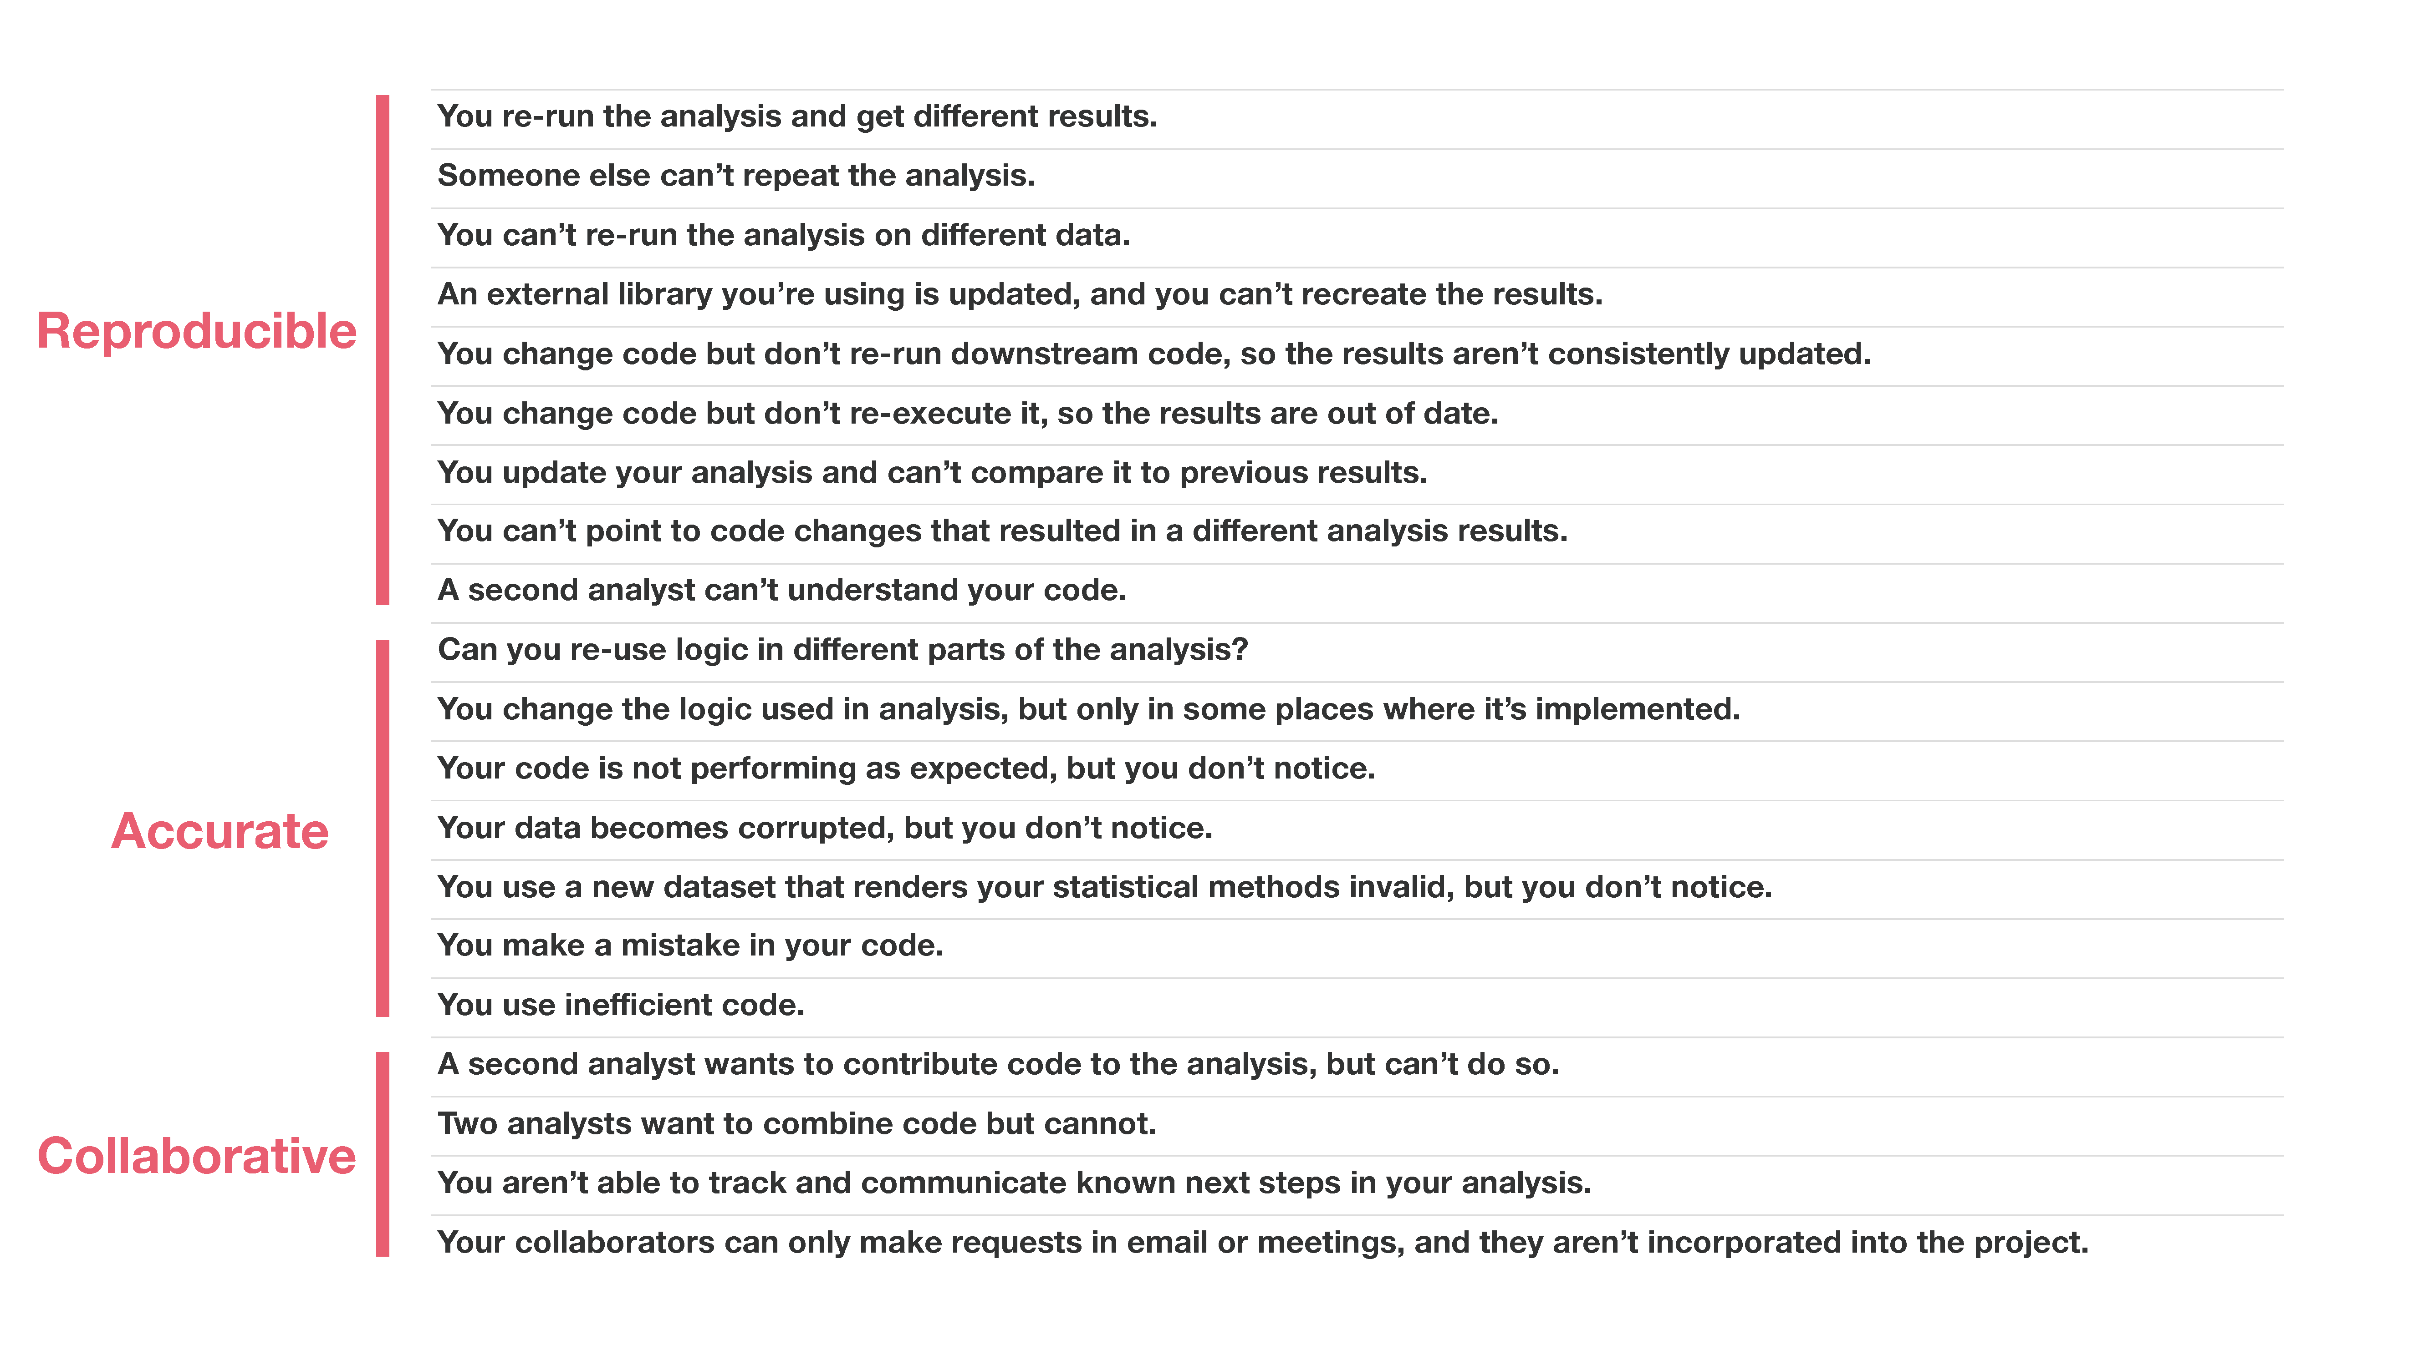
What will you learn?
How to generate, disseminate, and respond to market intelligence with data-informed insights to optimize collective value.
Source: Parker, Hilary (2017), “Opinionated Analysis Development,” a presentation delivered at rstudio::conf(2017) and available at: https://www.rstudio.com/resources/videos/opinionated-analysis-development/.
Notes:
w/Master - KK

Slide 13

What will you learn?
How to generate, disseminate, and respond to market intelligence with data-informed insights to optimize collective value.
Source: Kotler, Philip, and Gary Armstrong. Principles of Marketing. Pearson Education, 2010.
Notes:
w/Master - KK

Slide 14
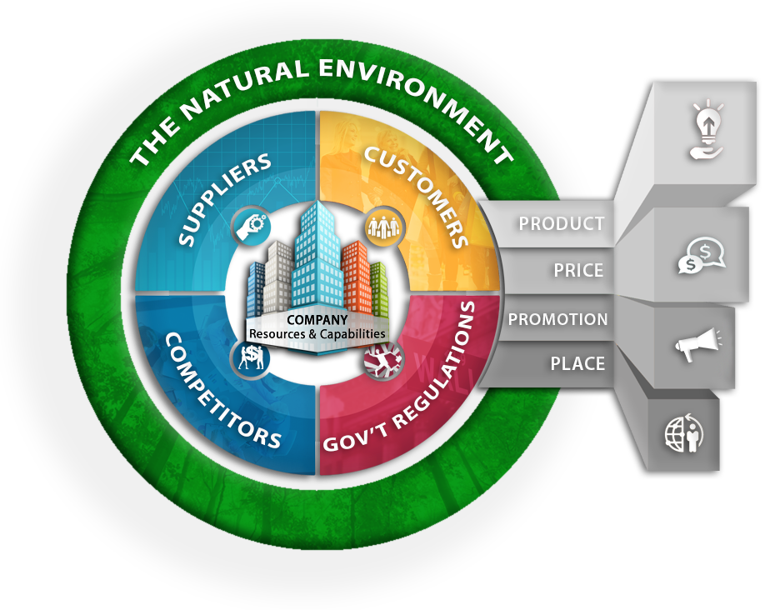
What will you learn?
How to generate, disseminate, and respond to market intelligence with data-informed insights to optimize collective value.
Source: Kohli, Ajay K. and Bernard J. Jaworski (1990), “Market Orientation: The Construct, Research Propositions, and Managerial Implications,” Journal of Marketing, 54 (2), 1-18.
Notes:
w/Master - KK

Slide 15

What will you learn?
Sabermetrics is to baseball scouts as customer analytics is to what?
How to generate, disseminate, and respond to market intelligence with data-informed insights to optimize collective value.
Source: Donaldson, Thomas and James P. Walsh (2015), “Toward a Theory of Business,” Research in Organizational Behavior, 35, 181-207.
Notes:
w/Master - KK

Slide 16
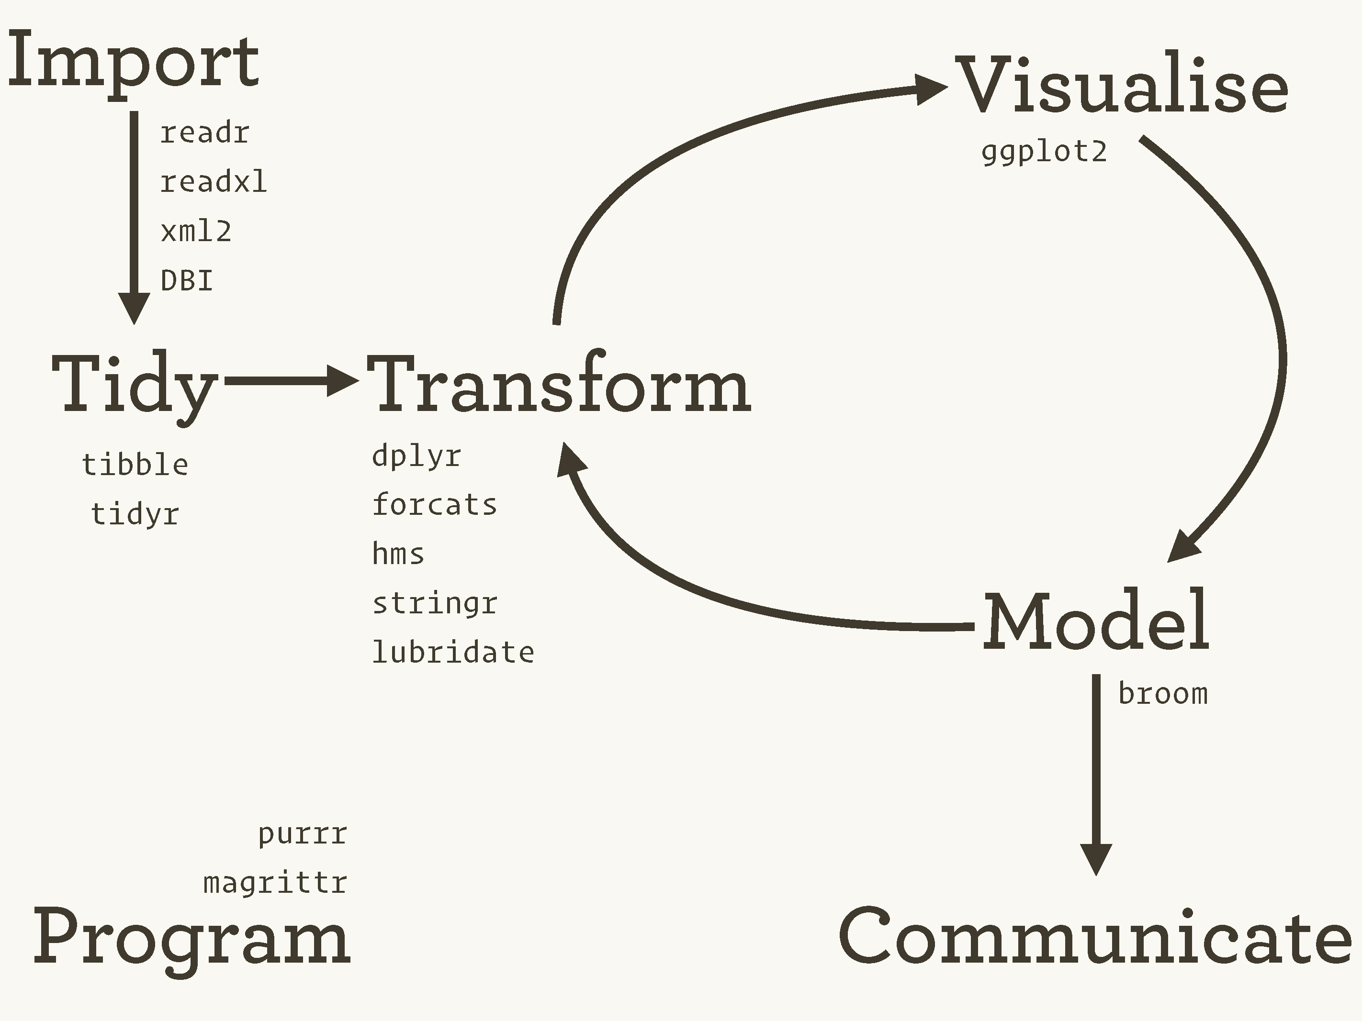
What will you learn?
How to use the tidyverse to import, tidy, transform, and visualize customer data; and how to share the insights you generate in ways that will enhance marketing-mix decisions.
www.tidyverse.org
Notes:
w/Master - KK

